Slide 1

Localizing your ASP.NET Core Applications
Rick Strahl
West Wind Technologies
west-wind.com
weblog.west-wind.com
@RickStrahl
session materials: https://github.com/RickStrahl/Westwind.Globalization

Slide 2







About the Presenter
Rick Strahl
Big Kahuna @ West Wind Technologies
Author and Speaker
Popular Blog: weblog.west-wind.com
ASP.NET Insider and MVP
Tools and Components
@RickStrahl
rstrahl@west-wind.com
weblog.west-wind.com

Slide 3
Agenda
Overview of Globalization/Localization
Localization in .NET in General
Localization in ASP.NET Core
Extending Resource Localization
Data Driven Localization

Slide 4
What is Globalization
Running an application in multiple locations
Displaying location specific formatting (Number, Dates etc.)
Translating text to specific languages (string localization)
Providing culture specific features
String Localization is usually what we refer to with 'Localization'
Key .NET Elements
Cultures and Culture Mapping via CultureInfo
Complete Unicode Support
Resource based Localization (RESX)
Full Framework and .NET Core use same Semantics
ASP.NET / Core adds Localization scheme on top of .NET Base

Slide 5
What do you need to Localize?
System Formatting
Date Time Formatting
Numeric Formatting
Operations (sorting and conversions for example)
Static Text Translation
All static text needs to be translated
Controls can be localized
But literal text in a page can’t be localized!
Data and Content Translation
Application specific concern
Not the focus of this session

Slide 6
What's in a Culture/Locale
Culture identifies a Location/Region
Specific Language and Country
Determines both formatting and resource translation
Identifying Cultures
Language Code – ISO 639-1 en, fr, es, de
Country/Region Code – ISO 3166 US,CA,MX,CH
Locale Id (LCID) en-US, es-MX, fr-CA, de-DE, de-AT
Cultures in .NET
Culture (date and numbers) and UICulture (resources)
Current Culture is tied to a thread
Hierarchical structure
Resource fallback: en-US -> en -> Invariant

Slide 7
Cultures in .NET
CultureInfo Class
CultureInfo holds information about a Culture
Language code + region code
new CultureInfo("fr-CA")
Cultures are determined by Thread
Thread.CurrentThread.CurrentCulture / CurrentUICulture
ASP.NET assigns default Culture to every request thread
Auto Culture or manual assignment can override Culture
CurrentCulture
DateTime and Numeric formatting and conversion
Controls common output formatting ( ie. .ToString() )
Controls data parsing (ie. DateTime.Parse(), Decimal.Parse() )
CurrentUICulture
Used for Resource access in localization
ResourceManager, Global and Local Resources

Slide 8
UI Culture Resource Lookups
Resource Fallback
Specific Language and Country (de-AT)
Generic Language (de)
Invariant Culture ()
Default Neutral Locale Attribute
ResourceManagers track available Locales
Overriding the ‘default language’
Assembly level attribute can define ‘neutral’ Locale
[assembly: NeutralResourcesLanguageAttribute("en-US")]
Looks in the default assembly first for this Locale
Improves performance for default Locale

Slide 9
Resource Storage
ResourceSets
Loaded exactly once from source (Resx, db, etc.)
One ResourceSet per Resource, per Locale
For Resx: maps to content of single Resx resource file
Resource Manager
Only resource access interface
Loads Resources with a ResourceReader
Holds static dictionary of ResourceSets
Loads once per Application Domain/Application
Performance
Not an issue in most cases
Resourcesets load exactly once each
Downside: If resource loading fails: No resources at all!
Make sure you use the same Resource loading mechanism

Slide 10
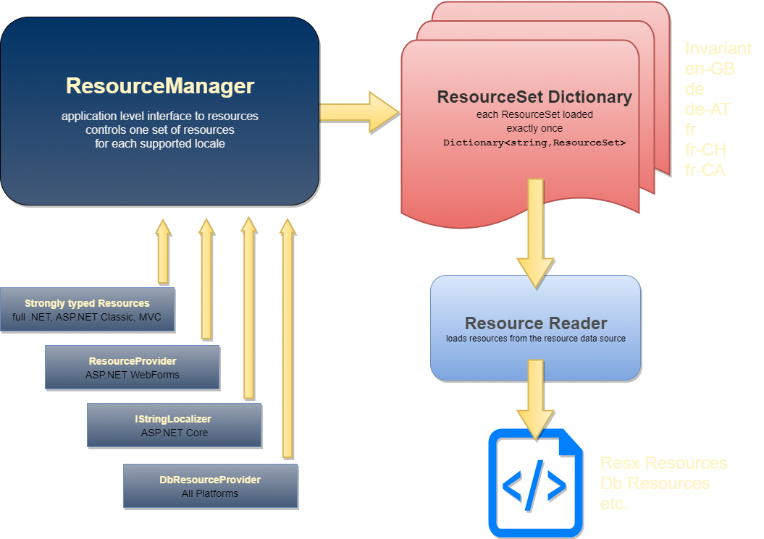
.NET Resource System

Slide 11
Localization in ASP.NET Core
Many high level changes
but underlying .NET concepts
stay the same as in classic .NET

Slide 12
.NET Core Localization Features
DI Based Resource Access
IStringLocalizer<T>
IHtmlStringLocalizer<T>
IViewLocalizer
Convention based on <T> typename as Resource 'path'
String Based Localization
Localizer["Resource String"]
Missing resource returns key
Supports localization by string rather than by ID
Questionable whether that's a good idea!
Automatic Resource Configuration
AddLocalization() enables Localizer Service
UseRequestLocalization() to configure locale selection
Supports 'Supported Resources'

Slide 13
What about Strongly Typed Resources?
Still Works
You can use strongly typed resources in ASP.NET Core
Own set of resources
Resource Generation tooling currently works only in Visual Studio on Windows
ResourceManager/ResourceReader
.NET Core uses standard Resource APIs
Meaning: All existing .NET Resource use works
Overhead
Mixing IStringLocalizer and Strong Resources duplicates ResourceSets
Alternative: Use a third party provider that can handle both ☺

Slide 14
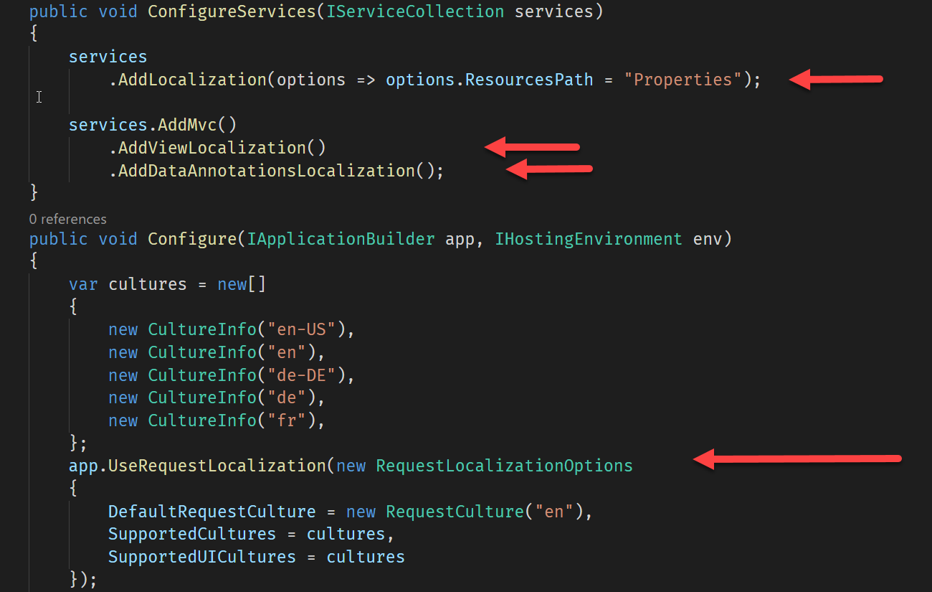
Localization Configuration

Slide 15
ASP.NET Core Localizers
Localizers are Injected
Controller Injection for String and HTML localizers
View injection for View localizer via @inject
Controllers use type to identify resources
IStringLocalizer<MyController>
Resource Name based on type: Controller.MyController
IStringLocalizer
Localizes a string – type used as ResourceSet indiciator
HTML Encoded when embedded into a view
IHtmlLocalizer
Localizes a string - type used as ResourceSet indiciator
Not HTML Encoded when embedded into a view
IViewLocalizer
Injected into Views
Resource Name based on View Path: Views.Home.About

Slide 16
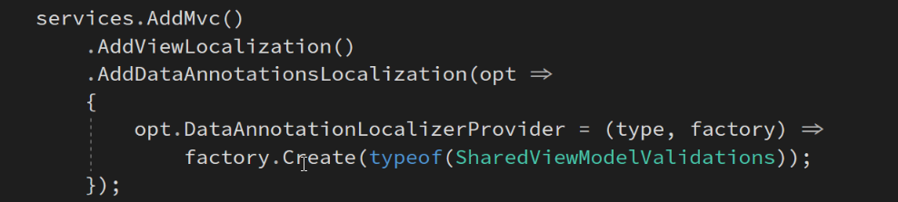
Data Annotation Localization
Automatic Resource Lookup
Models automatically check for Resources in ErrorMessage
View Model Type Localization
By default the type of the Annotation is used for localization
Example Resx Name: Models.PersonViewModel.resx
Sharing Resources
You can use a shared resource file for all DataAnnotations
Create an empty class and map as Resx file
Example: (Properties.SharedViewModelValidations)

Slide 17
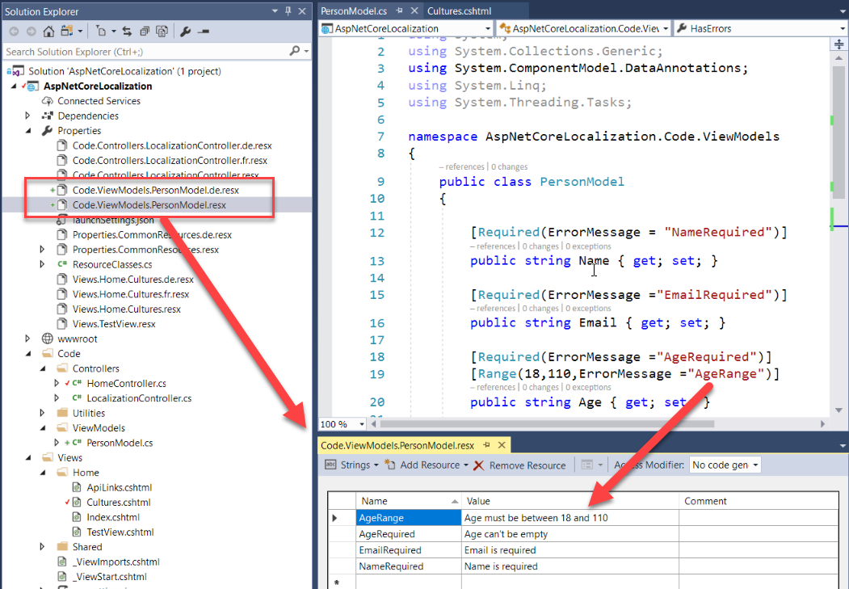
Data Annotation Localization

Slide 18
Data Driven Resource Localization
Resources from a Database
and interactive Resource Editing

Slide 19
Limitations of Resx
ResX works…
Built in functionality
Fast and efficient
Compiles into default assembly
Visual Studio has Tooling
But…
Resource Editing Resx files sucks
Resources are hard to manage
Stock Resourcesmanager Limitations
Resources are static at runtime (compiled)
No dynamic changes to localized content
Can't unload at runtime
Any changes require recompilation

Slide 20
Using Data Driven Localization
Runtime Translation
Allows loading and changing the data dynamically
Web based editing and previewing
Developers, translators and users can edit
More Control
Easier to manipulate Resources (it's a database after all)
Ability to export to Resx Resources
Ability to import Resx Resources
Performance
DataBase Resources are no slower than Resx
Using standard .NET Resource Managers
Resource Caching
Live Resource Reloading

Slide 21
Data Driven Resource Provider
Reads data from database
Resource keys are stored in database
Values are read from the database
Remember: ResourceSets are cached after initial read
Data Access Layer
All database access routed through Data Manager
Resource editing requires many different views and various update mechanisms
Maps Resx file Resource 'structure'
Allows exporting back to Resx files
Web based Resource Admin Front End
Allows easy editing and adding of localization data
Real time updating of resource data for preview
Context sensitive access (with a Localization Control)
Many small useful features

Slide 22
West Wind Globalization
Data Driven Resource Provider
Supports storing resource data in a database
Sql Server, SqLite, MySql, SqlCompact support
https://github.com/RickStrahl/Westwind.Globalization
Import and Export from Resx
Import resources from Resx to edit existing resources
Export resources back to Resx once done localizing
Optionally – continue to run with Resx Resources
Localization Administration Interface
Provides a rich resource editor
Uses database resources
See resources for each language next to each other
Gridview for fast editing
Translation via Google Translate and Bing Translation

Slide 23
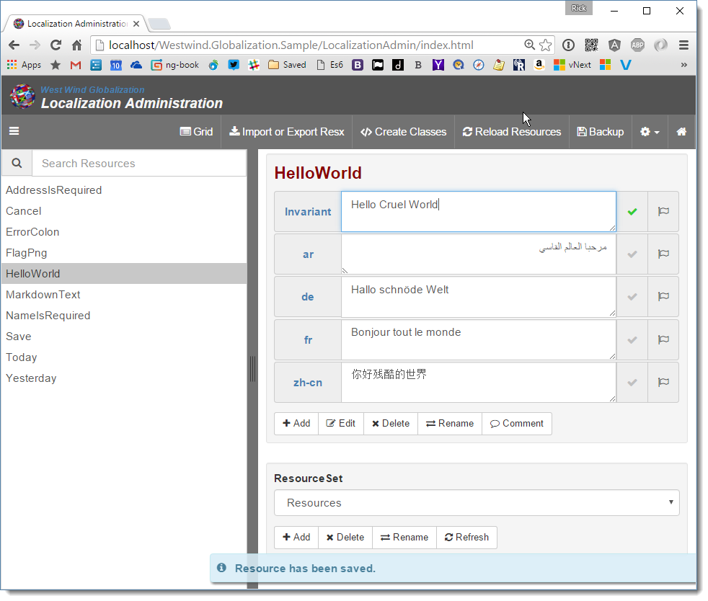
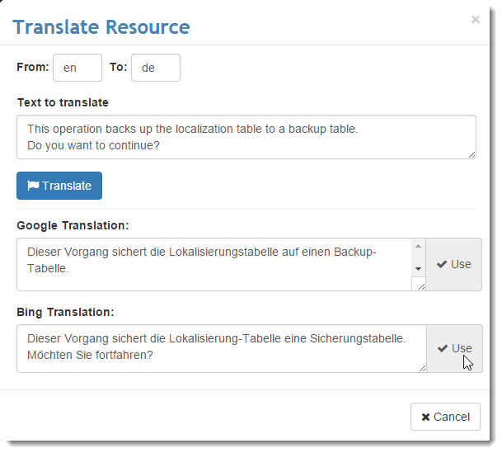
Localization Administration

Slide 24
Resx Import and Export
Resource Import and Export
Imports Resx Resources from a folder (or individual)
Exports Resx Resources to a Folder
Best of Both Worlds
Interactive resource editing during development
Much more productive edit environment
Optionally customizable editing UI
Optimized Resx resources for deployed applications
Switching between
Easy to switch between Resx and DB Resources
Simply don't use Westwind StringLocalizers to use Resx during startup configuration.

Slide 25
Pros and Cons of Data Resource Provider
Pro
Real time editing and preview of resources
Ability to provide and create custom tools
Provided Localization Administration Editor
Easy to manipulate, copy and munge Resources
Provide translation services
Con
Doesn't package as nicely as ResX
Requires a Database
Requires Configuration
If misconfigured can break application!
Not an issue:
Performance – db Provider is no slower than ResX

Slide 26
Thank You!
Samples Links
Samples, Documents on GitHub https://github.com/RickStrahl/DI2017-ASP.NET-Core-Localization
West Wind Globalization https://github.com/RickStrahl/Westwind.Globalization
Resources
ASP.NET Core Localization Documentation
Quick Language Switcher Addin for Chrome
Contact Rick
https://weblog.west-wind.com
@rickstrahl
rstrahl@west-wind.com

